Slide 1
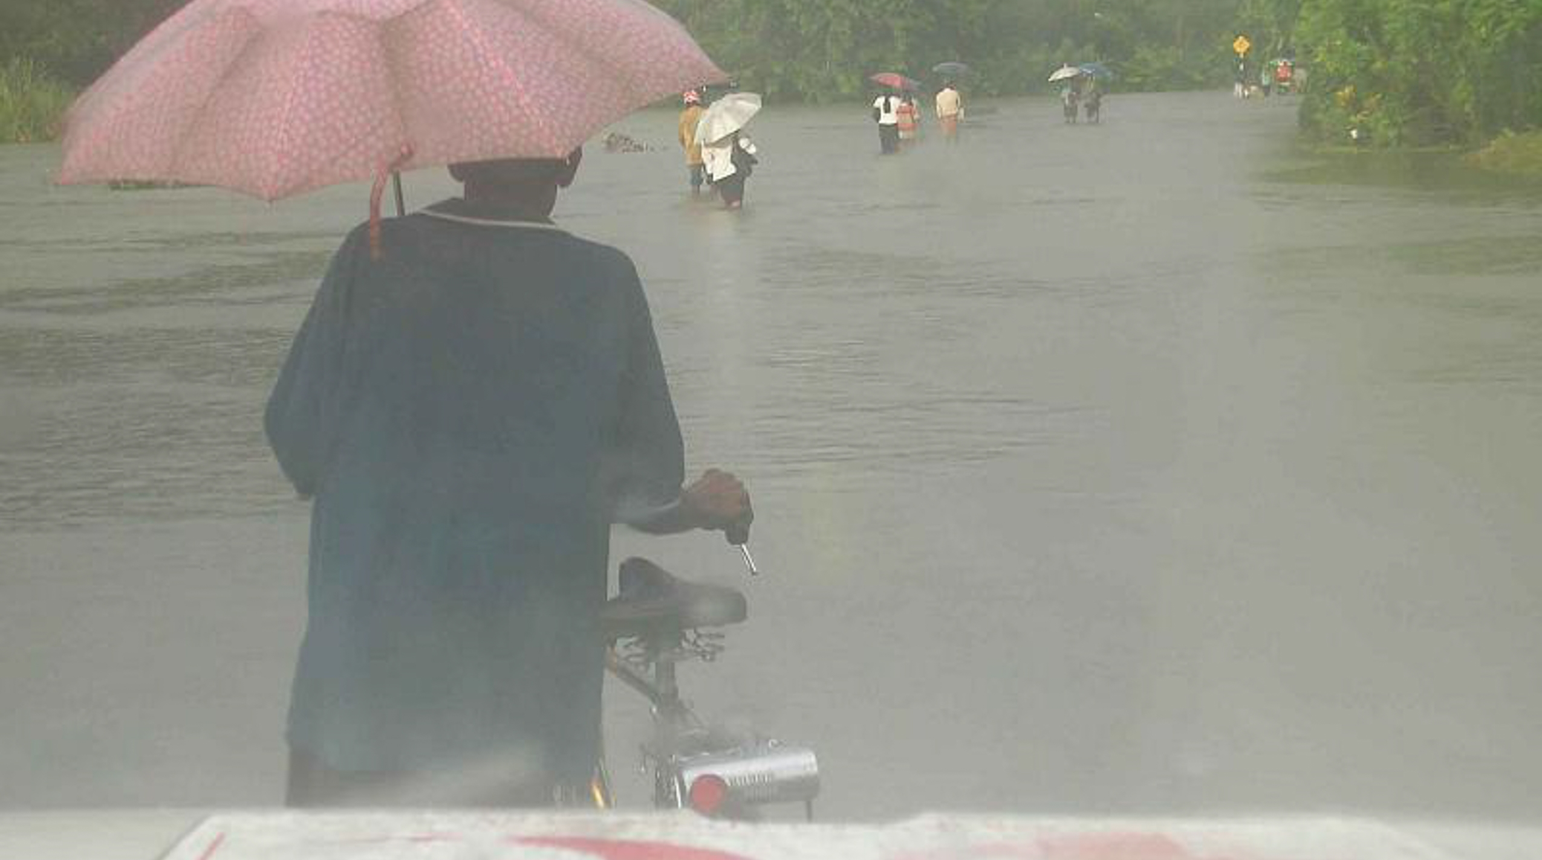
Climate-related displacement
Part 3 – law and advocacy
Photo: IFRC – P. Fuller
Notes:
Introduction for facilitators:
These slides aim to facilitate an understanding of the legal and policy frameworks for displacement and climate, and the role of advocacy in strengthening the development and implementation of laws and policies at national level.
It is targeted to personnel from National Societies with roles in law and advocacy.
However, this powerpoint – Part 3 - contains a large selection of slides and the facilitator may need to prioritize and reduce for the intended audience and time available.
Overview of topics covered:
International legal frameworks
Human rights
Climate change
Displacement
Regional legal frameworks
National legal frameworks
Advocacy and dialogue
Speaking notes and references
The following Displacement and Climate Fact Sheets should be used as direct references and speaking notes:
#04 Red Cross Red Crescent approaches to displacement and climate
#12 The Law

Slide 2
Overview of topics covered
International legal frameworks
  Human rights
  Climate change
  Displacement
Regional legal frameworks
National legal frameworks
Advocacy and dialogue

Slide 3
International legal frameworks
on displacement and climate

Slide 4



Types of legal instruments
Hard law: legally binding on states such as international treaties and conventions
Soft law: not legally binding but an expression of common standards, principles and commitments.
International guidance: non-binding guidance on the application or implementation of hard and soft law and international best practice.

Slide 5
Some general observations
There is no dedicated international treaty on the complex issue of climate-related displacement.
However:
  International human rights law underpins all issues relating to displacement and the impacts of climate change.
  There are international treaties addressing displacement and climate change as separate issues.
  There is increasing recognition in more recent soft law instruments and international guidance about the inter-relationship between displacement and climate change and the principles and standards that should apply.

Slide 6
Overview of the international legal framework

Slide 7
International human rights law
Underpins the legal framework for people displaced by climate-related disasters and the adverse impacts of climate change.
Comprises fundamental rights and freedoms of all persons at all times, irrespective of nationality, legal status or other circumstance.
Main instruments:
International Covenant on Civil and Political Rights (ICCPR) (1966).
International Covenant on Economic, Social and Cultural Rights (ICESCR) (1966).
Further instruments:
Convention on the Elimination of all Forms of Discrimination Against Women (CEDAW) (1979).
African Charter on Human and Peoples’
Rights (1981).
Convention on the Rights of the Child
(CRC) (1989).
Convention on the Rights of Persons with
Disabilities (CRPD) (2006).

Slide 8
Some fundamental human rights and freedoms:
Right to life and survival
Right to freedom of movement
Right to an adequate standard of living including food, clothing and housing.
Right to physical and mental health
Right to self determination
Right to freely pursue economic, social and cultural development
Right to equality between men and women
Right to equality before the law and equal protection

Slide 9
Human rights in the context of climate-related displacement
Various UN bodies and Special Rapporteurs have recognised the threats to human rights posed by displacement, disasters and climate change including in the context of:
  The slow onset effects of climate change and human rights protection for cross-border migrants (OHCHR)
  Internal displacement in the context of the slow-onset adverse effects of climate change (Special Rapporteur on the Rights of Internally Displaced Persons)
  Human rights, climate change and migration (OHCHR)
  Challenges and obstacles to the right to the enjoyment of a healthy environment (Special Rapporteur on Human Rights and the Environment)
  Displacement caused by natural disasters and environmental, both internal and transboundary (Special Rapporteur on Human Rights and the Environment)

Slide 10
International law on climate change
There are a number of international treaties which seek to address the overall challenge of climate change, including displacement.
These have lead to the development of specific international guidance to address displacement in more detail.

Slide 11
International climate treaties
UN Framework Convention on
Climate Change (1994)
Intergovernmental forum for negotiating the global response to climate change.
Aims to stabilize greenhouse gas concentrations to prevent dangerous interference with the climate system.
UNFCC Cancun Agreements
(2010)
Paris Agreement
(2015)
Establishes ‘the global goal on adaptation of enhancing adaptive capacity, strengthening resilience and reducing vulnerability to climate change,’
Acknowledges the global nature of climate change and its adverse effects.
Calls for cooperation and participation in an effective and appropriate international response.
Recognises the need to ‘develop recommendations for integrated approaches to avert, minimize and address displacement related to the adverse impacts of climate change’ and operationalize such recommendations to address loss and damage.
take ‘[m]easures to enhance understanding, coordination and cooperation with regards to climate change induced displacement, migration and planned relocation, where appropriate, at the national, regional and international levels.’
Calls on the international community, among other things, to:

Slide 12
COP Taskforce on Displacement
The UNFCCC established a Conference of the Parties (COP) to support further agreements and implementation on climate commitments.
In 2015 the COP established a Taskforce on Displacement (IFRC is currently a member).

Slide 13
International law on displacement
Most treaty law concerns cross-border movements of refugees, migrant workers and human trafficking.
Internal displacement and displacement as a result of disasters and/or climate change is generally addressed in soft law instruments and international guidance.

Slide 14
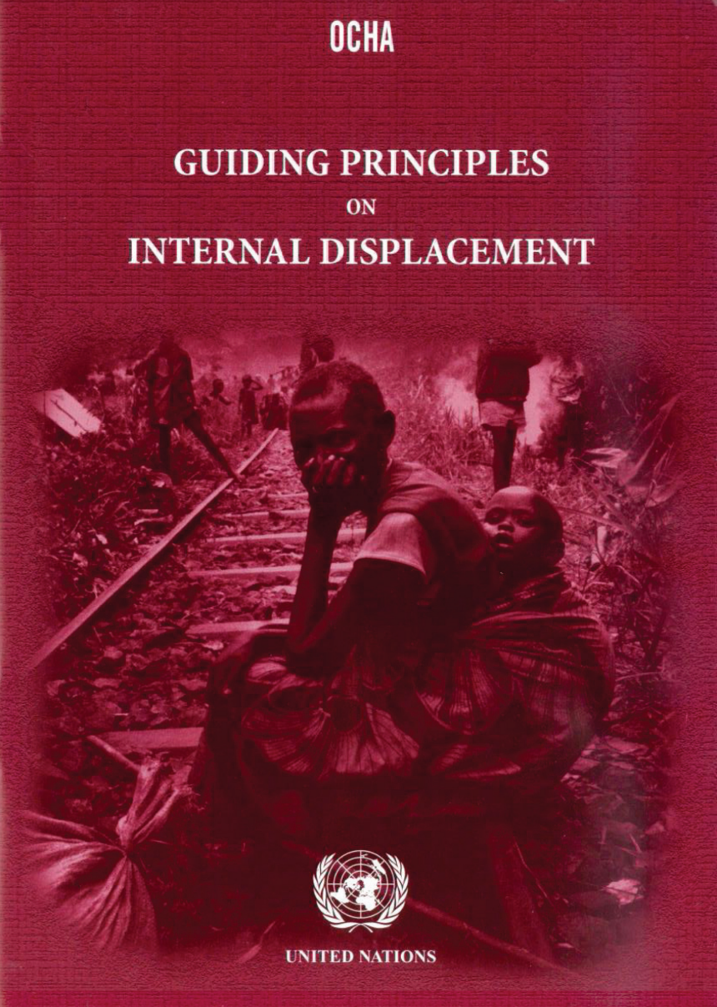
Internal displacement
UN Guiding Principles on Internal Displacement (1998)
Compile and elaborate existing principles of existing international law as applicable to people who are internally displaced.
Displacement may be as a result of conflict, human rights violations and disasters (which could include the impacts of climate change).
Among the 30 principles include:
  the prohibition of arbitrary displacement, except evacuation or necessity;
  protection against forcible return;
  recognition of the fundamental human rights
  access to and protection of humanitarian assistance; and
  full participation of internally displaced people in their own voluntary return, resettlement or reintegration.

Slide 15
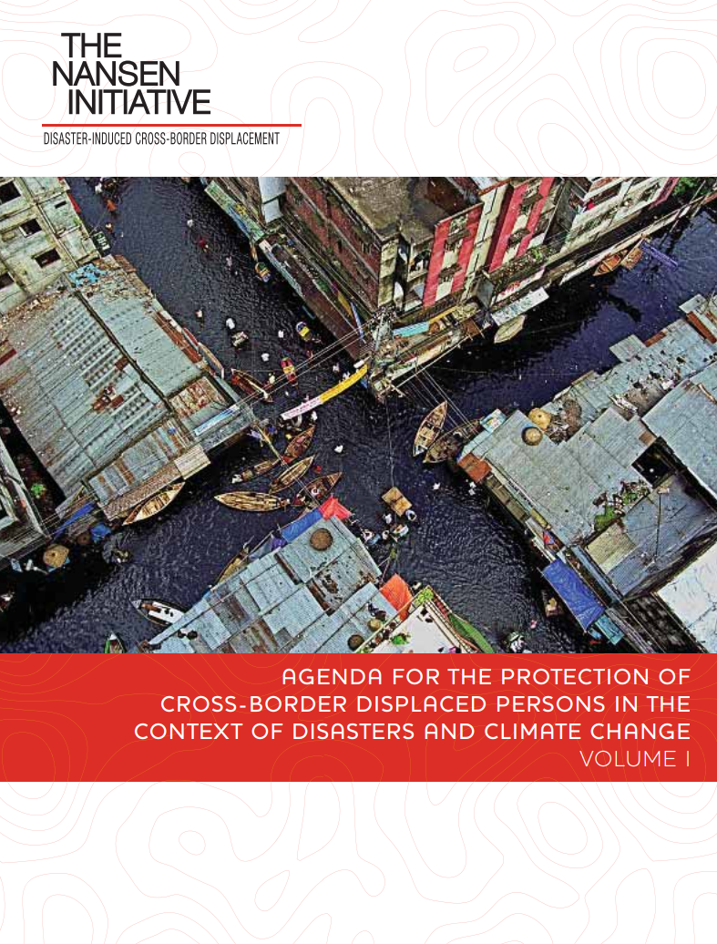
Cross-border displacement
Agenda for the Protection of Cross-Border Displaced Persons in the Context of Disasters and Climate Change (2015)
complements existing international frameworks and provides evidence and examples for States and other actors at all levels to:
  improve preparedness and response capacity to address cross-border displacement;
  take measures to manage disaster displacement risks in the country of origin;
  consider effective practices used by States and other actors to address cross-border displacement;
  understand the root causes and importance of inter-linking policies and collaboration;
  improve data collection and knowledge; and
  enhance humanitarian protection.

Slide 16
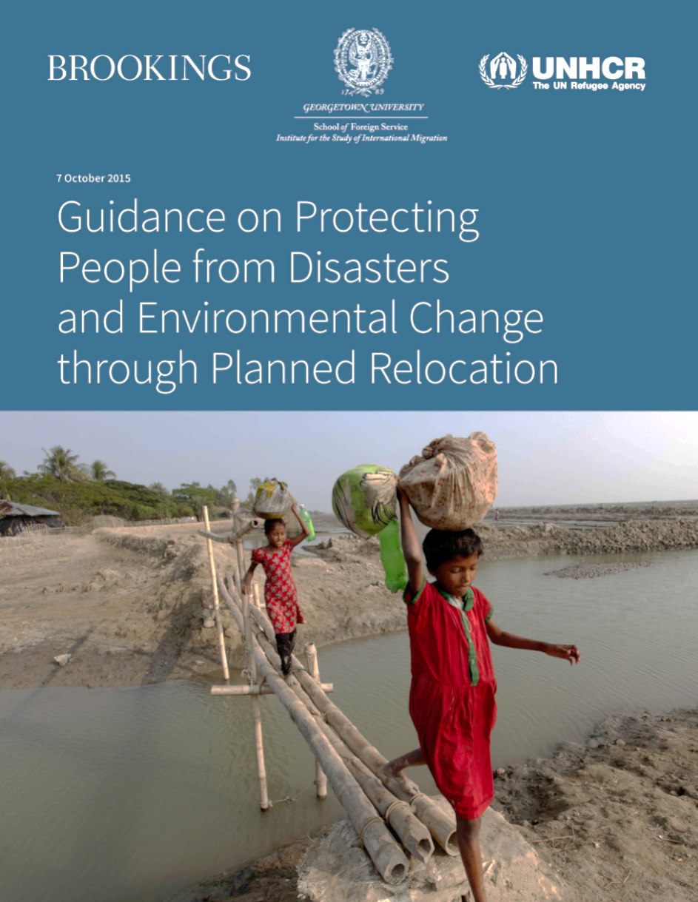
Planned relocation
The Guidance on Protecting People from Disasters and Environmental Change through Planned Relocation (2015)
Sets out general principles to assist States and other actors faced with the need to undertake ‘planned relocation’ within national borders, including when formulating planned relocation laws, policies, plans and programmes.
Toolbox provides specific measures and examples of good practice.
Checklist of key issues and questions to assist decision makers when developing, reviewing or amending domestic law and policy for planned relocations.

Slide 17
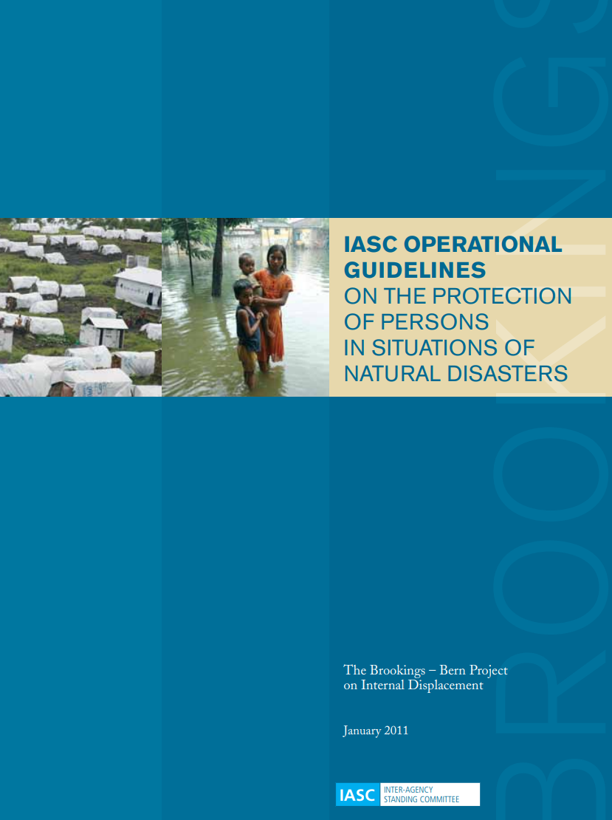
Evacuations, housing, land and property
IASC Operational Guidelines for the Protection of People in Situations of Natural Disasters (2011)
Applies a human rights based approach to key protection issues for people affected by natural disasters, including:
  Evacuations: When necessary but people should not be forcibly evacuated unless a number of specific criteria are met.
  Housing, land and property rights: Ensuring adequate protection of their homes, land and possessions and measures to ensure access to ownership and identity documents, legal protections and rapid judicial and administrative procedures, in particular for women.
  Durable solutions: Protection of rights related to documentation, free movement in the context of durable solutions for internally displaced persons; re-establishment of family ties, expression and opinion; and elections.

Slide 18
Regional approaches
to legal frameworks in the context of displacement and climate

Slide 19

Americas
Free Movement Agreements (FMAs)
Pacific
Africa
Framework for Resilient Development in the Pacific: An Integrated Approach to Address Climate Change and Disaster Risk Management (FRDP) 2017–2030.
Intergovernmental Authority on Development adopted the IGAD Free Movement Protocol (2020) in Eastern Africa

Slide 20
Pacific
Framework for Resilient Development in the Pacific: An Integrated Approach to Address Climate Change and Disaster Risk Management (FRDP) 2017–2030.
Protecting individuals and communities that are vulnerable to climate change and disaster displacement and migration through:
Strengthening capacities of government and administrations
Targeted national policies and actions, including relocation and labour migration policies.
Integrating human mobility issues within disaster preparedness, response and recovery programmes and actions.

Slide 21
Americas
Free Movement Agreements (FMAs)
In normal times, liberalize migration between the member states of the Caribbean Community (CARICOM) and Organisation of Eastern Caribbean States (OECS).
In 2017 were used to facilitate planned and unplanned evacuation processes during the hurricane season in the Caribbean.

Slide 22
Africa
Intergovernmental Authority on Development adopted the IGAD Free Movement Protocol (2020) in Eastern Africa
Specifically protects the cross-border movement of people affected by disasters and climate change including:
Facilitating the entry and lawful stay for those who have been displaced.
Allowing pre-emptive movement of those at risk of displacement as a way of avoiding, or mitigating, the impacts of a disaster.
Allowing citizens of IGAD Member States to cross borders ‘in anticipation of, during or in the aftermath of disaster,’ and
Enabling disaster-affected people to remain in another country as long as return to their country of origin ‘is not possible or reasonable.’

Slide 23
National legal frameworks
for displacement and climate

Slide 24
Role of national law
National law plays an essential role in ensuring that international laws, standards and guidelines are effectively implemented.
States that ratify international treaties have mechanisms in place to ensure their provisions are put into effect, although this varies from country to country.
For soft law and other guidance, implementation is even less certain and often requires concerted advocacy and support from humanitarian and development organisations to ensure that commitments are fully realised.

Slide 25
Filling the gaps
Most countries have laws and policies relating to climate change and/or disasters, which establish the legal basis and institutional arrangements for addressing these risks from national to local level.
Unfortunately, research has shown that many issues relating to displacement in these contexts are poorly addressed or absent.
The IFRC has been engaged in disaster law issues for many years, including the development of international standards and guidance.
Through the network of National Red Cross and Red Crescent Societies, it has played an influential role in strengthening national disaster laws and policies in many countries and more recently has developed a set of Legal Checklists to further support this process.

Slide 26
IFRC Legal Checklists

Slide 27
IFRC legal checklists
Detailed guidance on strengthening national law and policy in the areas of:
  disaster risk reduction
  disaster preparedness and response
  international disaster response
Also address a number of important aspects with regard to displacement from climate change and disaster.
Developed through extensive review of global literature, as well as country case studies and good practice.

Slide 28
Considerations for national laws and policies
Disaster and climate-related displacement
Does the land and/or policy:
Address the reduction of the risk of disaster and climate displacement?
Include persons displaced by disasters and the effects of climate change?
Mandate contingency planning for internal displacement caused by disasters and the effects of climate change?
Include the identification, entry, stay and entitlements of cross-border disaster-displaced persons in a way which is consistent with human rights law?
Provide for cross-border disaster-displaced persons, including vulnerable displaced groups, to receive protection and assistance to meet their basic needs during their stay?
Establish criteria for determining when and under which circumstances cross-border disaster displaced persons may be returned?
  If yes, are those criteria consistent with international human rights law?
  If no, is there a law or policy regulating durable solutions for cross-border disaster displaced persons?

Slide 29
Considerations for national laws and policies
Planned relocation
Does the land and/or policy:
Establish a comprehensive framework for undertaking planned relocations?
If so, does that framework include provisions that:
    establish that planned relocation should be used as a measure of last resort and be conducted in accordance with relevant human rights;
    entitle potentially relocated persons to legally challenge a planned relocation;
  mandate a participatory approach to planned relocation involving all affected persons, including relocated persons and host populations;
  require that planned relocations improve, or maintain, the livelihood opportunities and living standards of relocated persons and host populations; and
  require that planned relocation mitigates adverse impacts on persons who live in close proximity to the areas from which persons are relocated.

Slide 30
Advocacy and dialogue
on displacement and climate

Slide 31
The role of National Societies
Advocacy and dialogue is important for ensuring that displacement and climate issues are being addressed effectively.
National Societies have a unique role to play, bringing perspectives from many levels:
  Local
  National
  Global
National Societies also have a role as “auxiliary to the public authorities in the humanitarian field” which includes engagement and dialogue on behalf of vulnerable people.

Slide 32
Displacement and advocacy
The Movement Policy on Internal Displacement places a strong emphasis on advocacy.
Principle 5 specifically affirms the Movement’s commitment advocacy and to empowering individuals and communities affected by displacement by “helping them to exercise their rights” including:
  Rights relating to physical safety and integrity (eg. right to life, freedom from torture, assault and rape)
  Rights to basic necessities (eg. food, water, health care, shelter)
  Other economic, social and cultural rights (eg. right to work and education, compensation for loss of property)
  Other civil and political rights (eg. to obtain personal documentation, political participation, non-discrimination)

Slide 33
Displacement and dialogue with authorities
The Movement Policy on Internal Displacement makes numerous references to the engagement with authorities and exercising the auxiliary role of National Societies. These include:
  Reminding authorities of their obligations under the normative framework for the protection and assistance of people affected by internal displacement
  Establishing a dialogue with authorities and gaining their trust through strict compliance with the Fundamental Principles
  Supporting authorities to meet their humanitarian responsibilities as auxiliaries, to the extent that resources, capacities and Fundamental Principles allow
  Limiting the extent to which the humanitarian responsibilities of authorities are substituted by the Movement, particularly where this is the result of a lack of political will rather than capacity
  Harnessing the Movement’s ability to gain access to decision-makers to prevent and respond to displacement
  Asking authorities and public services about arrangements for return and relocation programmes.

Slide 34
Climate and advocacy
Framework for Climate Action Area of Work 3: Influence and partner to increase our impact
The Framework defines success as:
  National Societies and the IFRC are able to successfully influence climate related laws, policies, plans and investments to prioritize the needs of the most vulnerable, and are increasingly recognized and consulted in this role.
  New partnerships are established with organizations and networks that strengthen our work and visibility in addressing climate change.

Slide 35
Climate and dialogue with authorities
National Adaptation Plans (NAPs)
At COP-17 in 2011, a decision was made to create National Adaptation Plans NAP for developing countries.
These are medium to long-term government plans and budgets for how to adapt to a changing climate and are closely aligned with development objectives (and SDGs)
National Societies can play an important role to:
Engage in dialogue with authorities about the development of NAPs.
Ensure communities and vulnerable groups are included in the plans – not just infrastructure.
Support local implementation and meeting the needs of the most vulnerable.

Slide 36
Climate-related displacement: What can we do?
Enhance the voices of people and communities experiencing climate-related displacement.
Share data and information to capture the scale and nature of the issues.
Share good practices on how to address climate-related displacement.
Engage in dialogue with national authorities to protect and respect the rights of people at risk / experiencing climate-related displacement.
Support the strengthening of national laws, policies and NAPAs to include and address climate-related displacement.
Participate in regional and international forums to bring climate-related displacement experiences from the field to the tables of decision-makers.
Build partnerships and coalitions, and facilitate local voices being heard, bringing coherence across humanitarian, development and climate agendas.
Local
National
Global

Slide 37
Explore more resources and tools
Climate Training Kit Module on Policy and Partnerships

